Slide 1
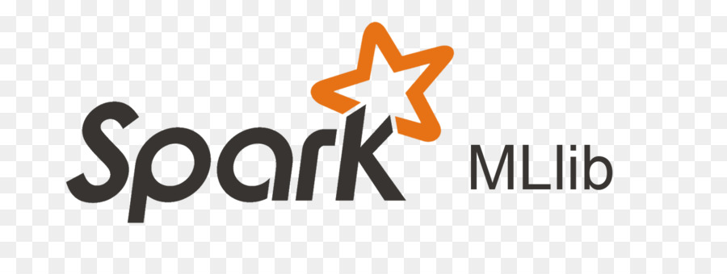

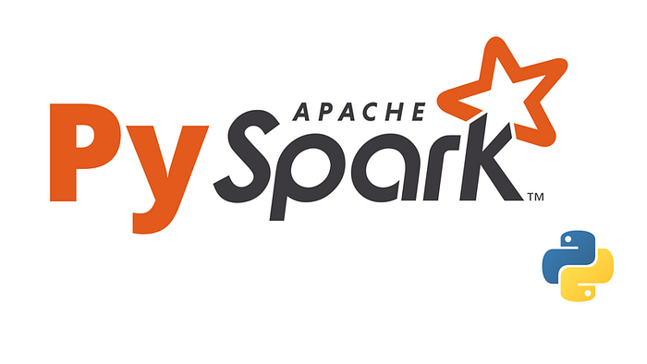






TECHNOLOGY STACK
Google Colab – Hosted Environment
Raw DataSet
Data Wrangling
Data Visualization
Train, Test, Save Model
Host API for Web UI

Slide 2

TECHNOLOGY STACK
Host API for Web UI
(Flask)
Raw DataSet
Data Wrangling
(pySpark, pandas)
Data Visualization
(mathplotlib)
Train, Test, Save Model
(pySpark ML Lib)
Google Colab Hosted Environment

